Slide 1
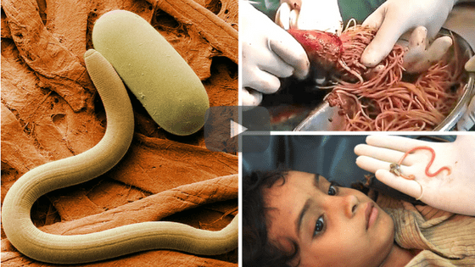
Parasitic Diseases of GI Tract

Slide 2
Infections of GI tract
Roundworm (Ascaris lumbricoides)
Whipworm (Trichuris trichiura)
Hookworm (Necator americanus and
Ancylostoma duodenale)
Pinworm (Enterobius vermicularis)
Thread worm (Tapeworms)
Roundworms, whipworms and hookworms have an obligatory period of development in soil

Slide 3
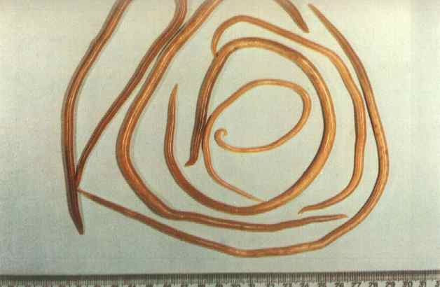
Ascariasis:
Scientific name: Ascaris lumbricoides
Adult worms (upto 30 cm in length)

Slide 4
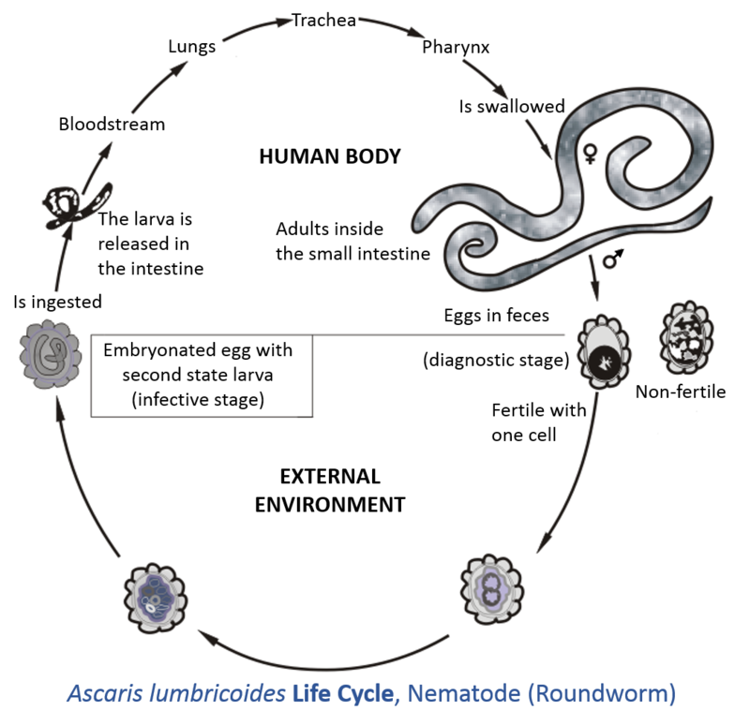
LIFE CYCLE:

Slide 5
Life cycle
Single host: only parasitizes humans
Adult worms live in small intestine; eggs passed out in faeces; obligatory period of development in soil
Climatic conditions must be suitable for eggs to develop
New infections acquired by ingestion of infective eggs
Larvae migrate through lungs during maturation

Slide 6
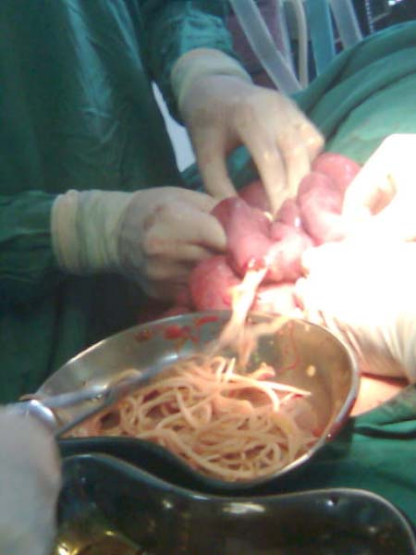
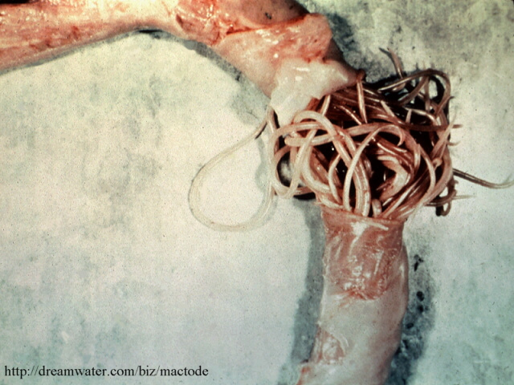
Clinical features
Most infections are light and asymptomatic
Malnutrition and stunting of growth in children
Intestinal obstruction and other complications in heavy infections (few cases)
Migrating larvae cause cough allergic type reactions

Slide 7
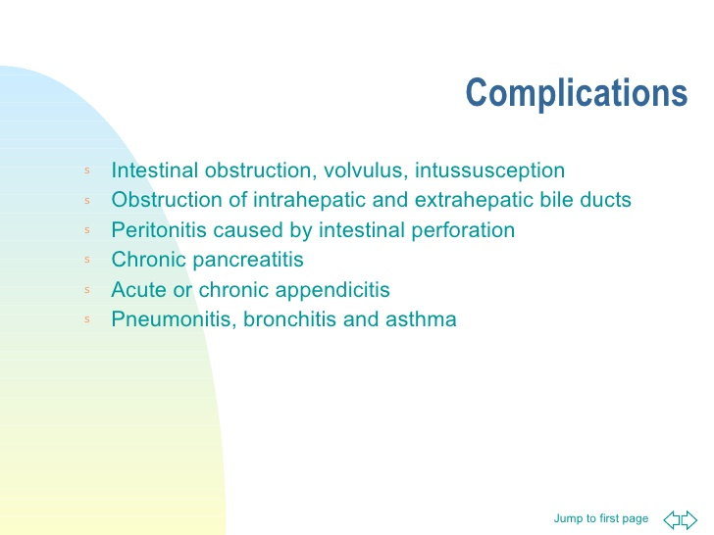

Slide 8
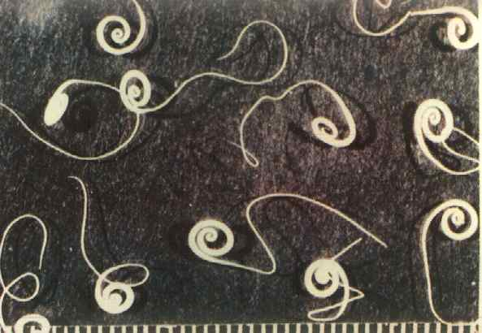
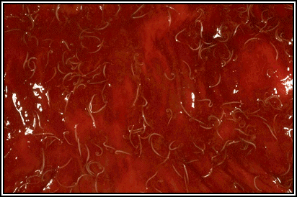
Trichuriasis:
Scientific name: Trichuris trichiura
Adult worms: 3 – 5 cm in length

Slide 9
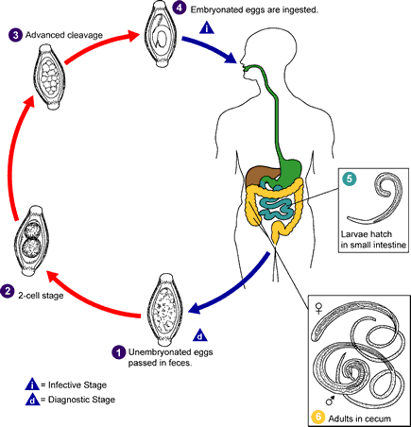
LIFE CYCLE:

Slide 10
Life cycle
Single host: only parasitizes humans
Adult worms live in large intestine; eggs passed out in faeces; obligatory period of development in soil
Ideal climatic conditions similar to those required for roundworm eggs
New infections acquired by ingestion of infective eggs
No larval migration

Slide 11
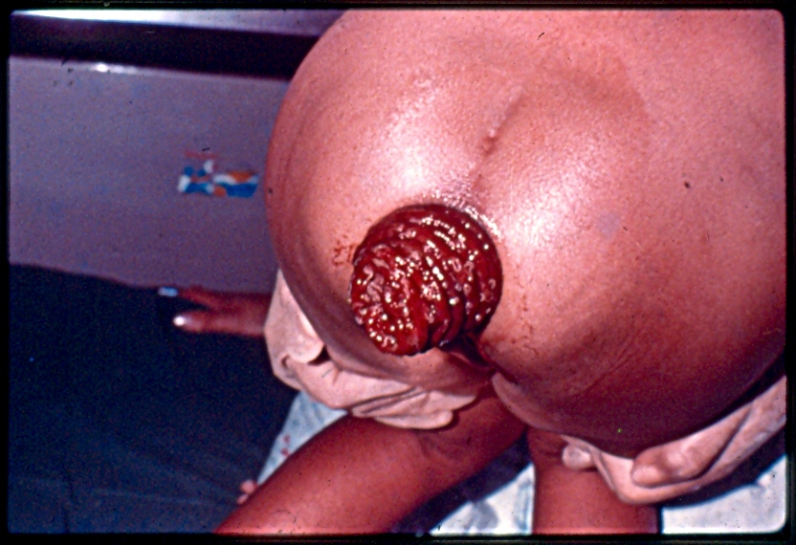
Clinical features
Malnutrition and stunting of growth in children
Impaired learning ability
In heavy infections:
Dysentery
Rectal prolapse
Epidemiology
As for roundworm

Slide 12
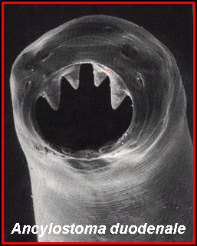
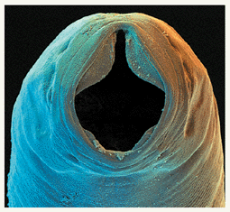
Hookworm Infections:
Scientific names:
Necator americanus,
Ancylostoma duodenale
Adult worms;
2 – 3 cm in length
whitish in colour
- Have cutting mouthparts
Mouthparts of adult hookworms

Slide 13
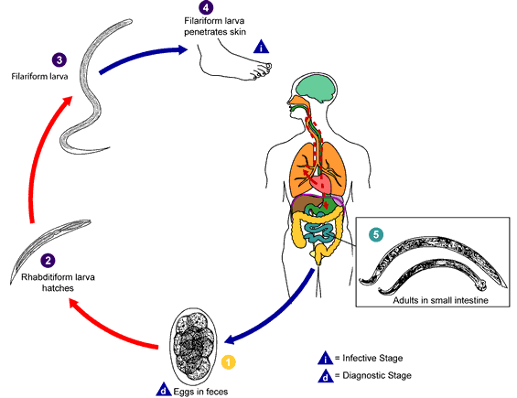
LIFE CYCLE:

Slide 14
Life cycle
Single host: only parasitizes humans
Adult worms live in small intestine; eggs passed out in faeces; obligatory period of development in soil
Climatic conditions must be suitable for eggs to hatch and larvae to develop in soil
New infections occur when larvae penetrate bare skin
Larvae migrate through lungs during maturation

Slide 15
Clinical features
Anaemia due to blood loss
Malnutrition and stunting of growth
Impaired learning ability
Epidemiology
Common in tropics; less so in subtropics
Prevalence increases with age (adults often infected)

Slide 16
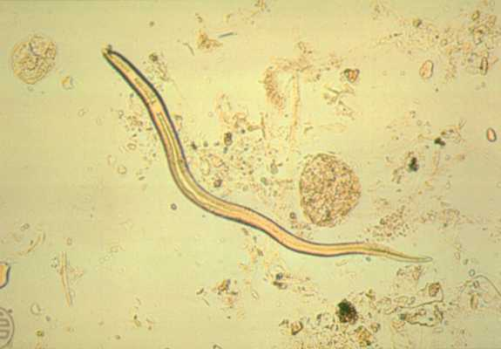
STRONGYLOIDIASIS
Strongyloides stercoralis

Slide 17
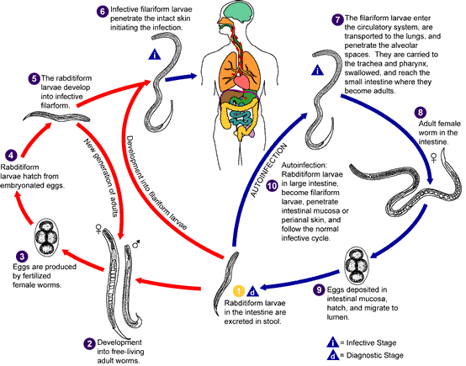
LIFE CYCLE:

Slide 18
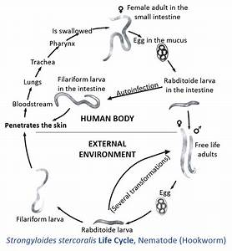

Slide 19
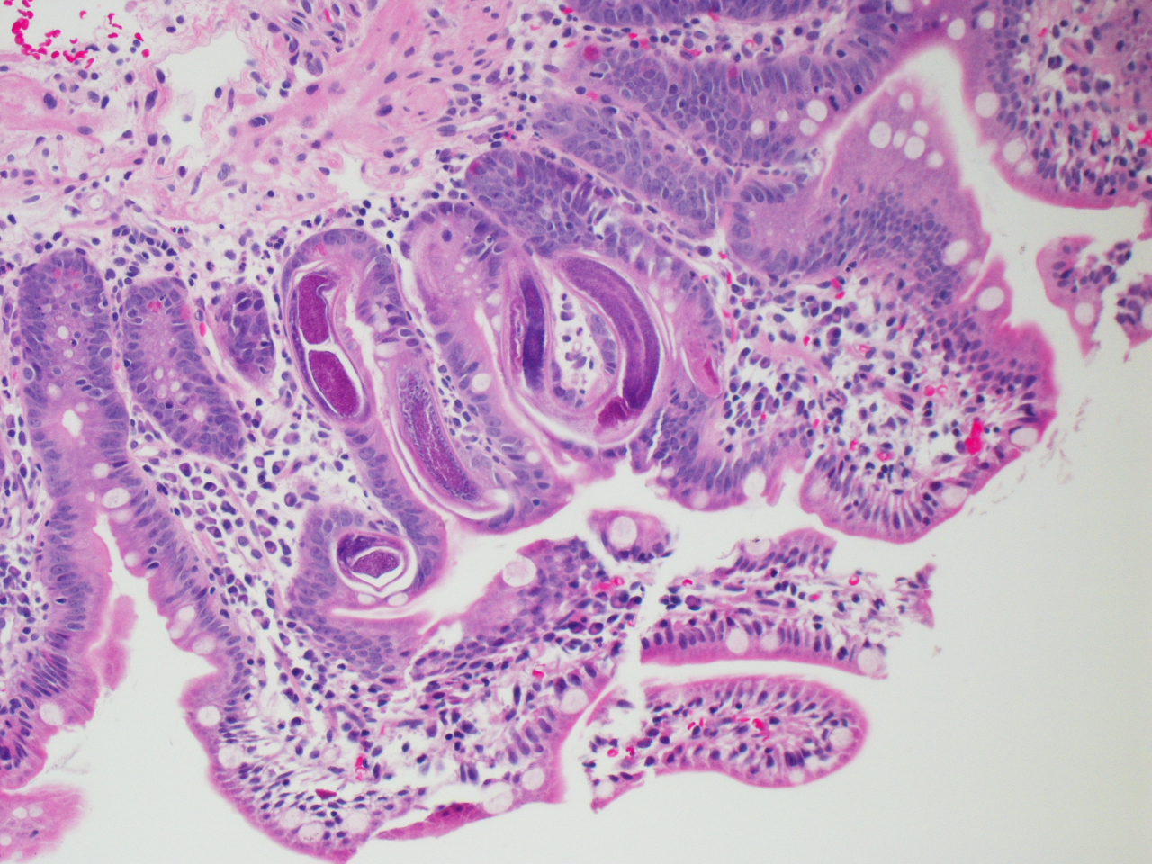
Section of Doudenum

Slide 20
Auto - infection
L₁ larvae develop into L₃ larvae inside bowel lumen
Re-invade body through intestinal mucosa (internal) or perianal skin (external)
Multiply indefinitely in humans – persistent infection (upto 20-30 years) even without external re-infection

Slide 21
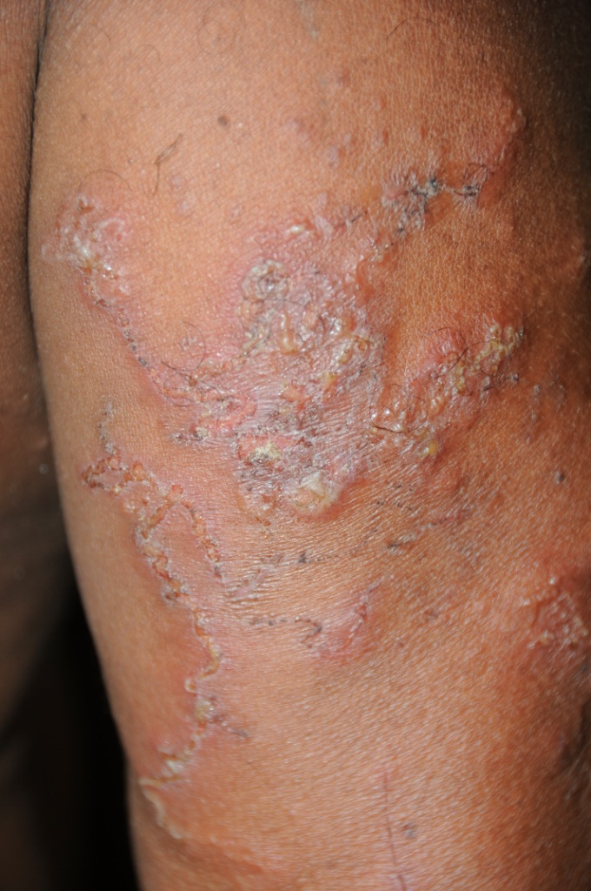
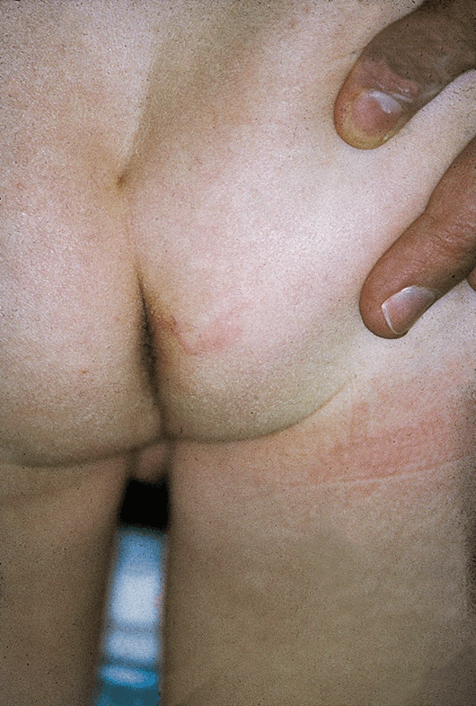
Clinical features
Immunocompetent individuals:
Larva currens - caused by migrating larvae
recurrent rash around anus & on trunk
linear appearance, itchy, transient
Urticaria - allergic rash in sensitised persons
Diarrhoea & enteropathy
Hypereosinophilia
Larva currens rash

Slide 22
Immunosuppressed persons:
Generalised, severe infection – disseminated strongyloidiasis
May be fatal
Severe diarrhoea with malabsorption
Oedema
Hepatomegaly
Paralytic ileus
Encephalopathy
Pyogenic meningitis

Slide 23
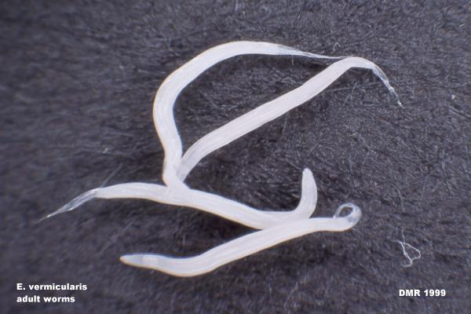
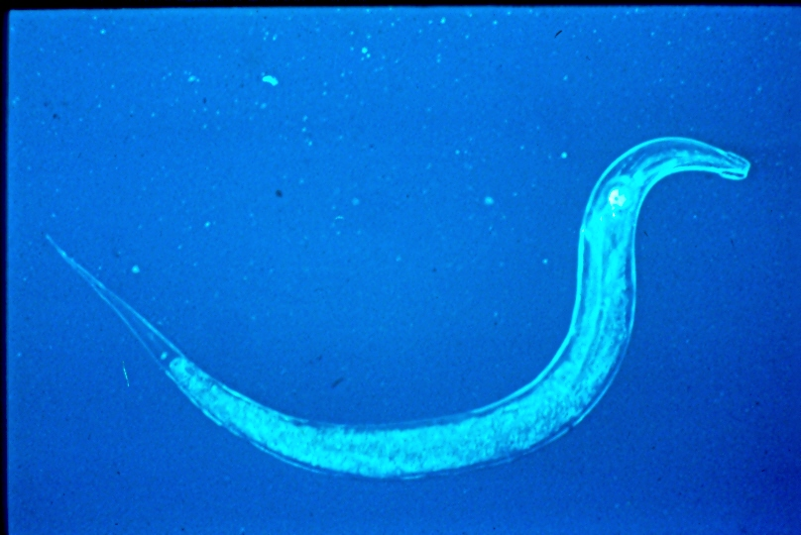
Enterobiasis:
Scientific name: Enterobius vermicularis
Adult worms 2 – 3 cm in length

Slide 24
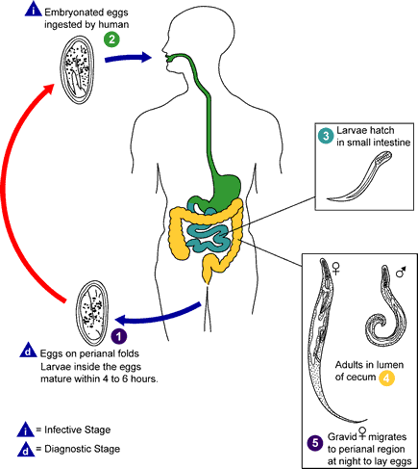
LIFE CYCLE:

Slide 25
Life cycle
Single host; infects only humans
Adults live in large intestine; eggs collect in female until all are mature;
Gravid female comes onto skin around anus at night and lays eggs on peri-anal skin
Eggs become infective within 6 h
Auto-infection common

Slide 26
Clinical features
Itching around anus at night
Insomnia, bed-wetting in children
Epidemiology
Common in temperate as well as tropical climates
Household infection, highest in conditions of overcrowding

Slide 27
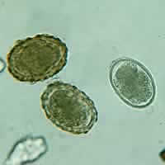
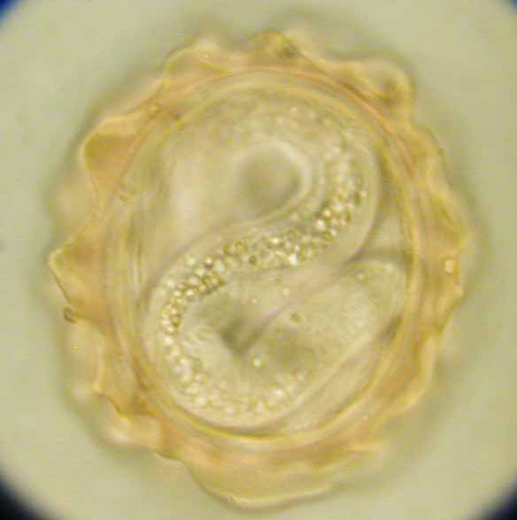
Diagnosis of intestinal worm infections
Examine faecal smears under microscope and look for worm eggs
Ascaris lumbricoides eggs

Slide 28
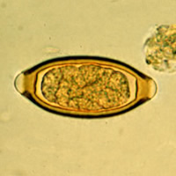
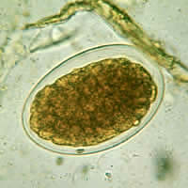
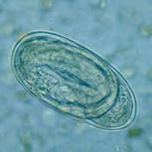
Trichuris trichiura egg
Hookworm eggs

Slide 29
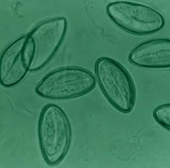
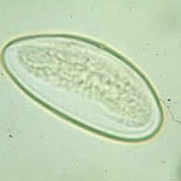
Diagnosis of infection enterobiasis:
Demonstration of adults or eggs on perianal skin
Eggs may also be seen in faeces (V. rare)

Slide 30
Treatment of worm infections
Deworming medicines are very effective, safe, and cheap
Mebendazole
Albendazole
Prevention and control
Mass deworming of children
Improved sanitation
Health education

Slide 31
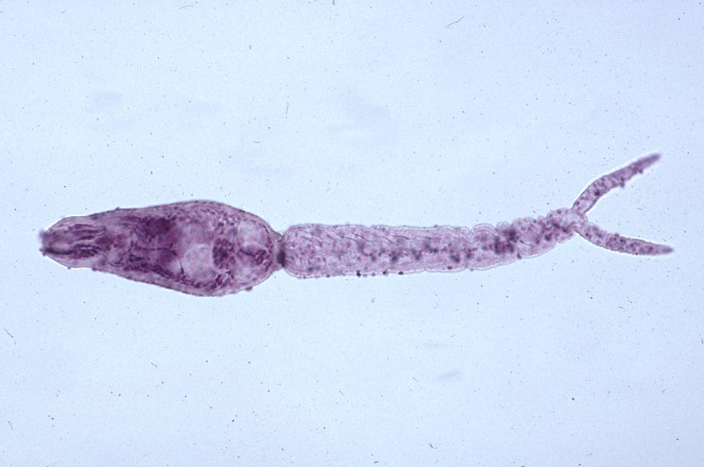
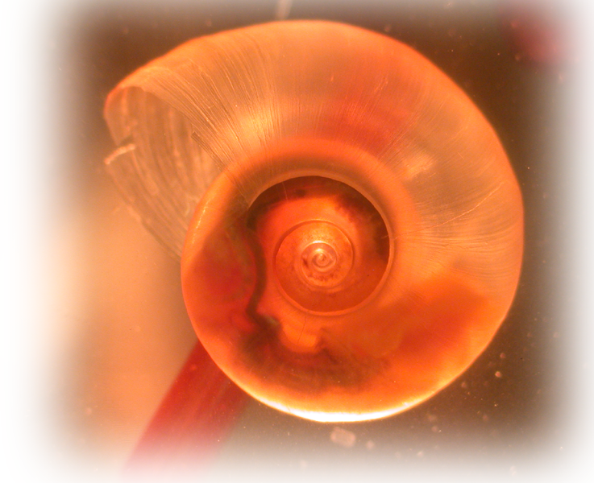
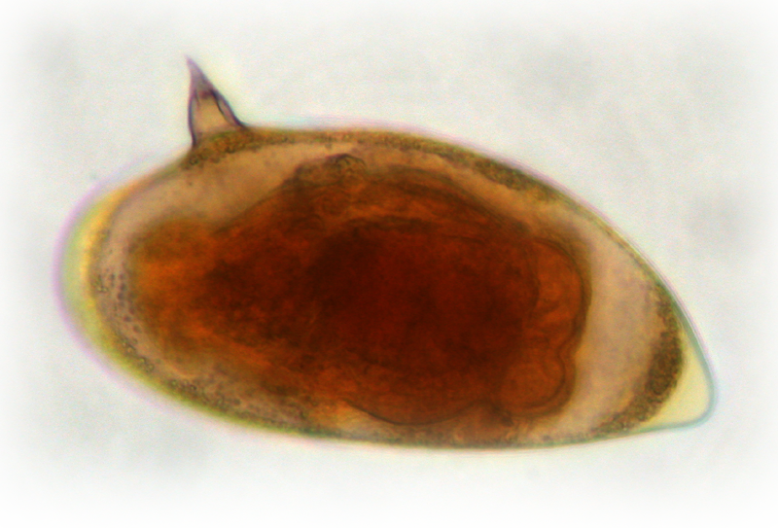
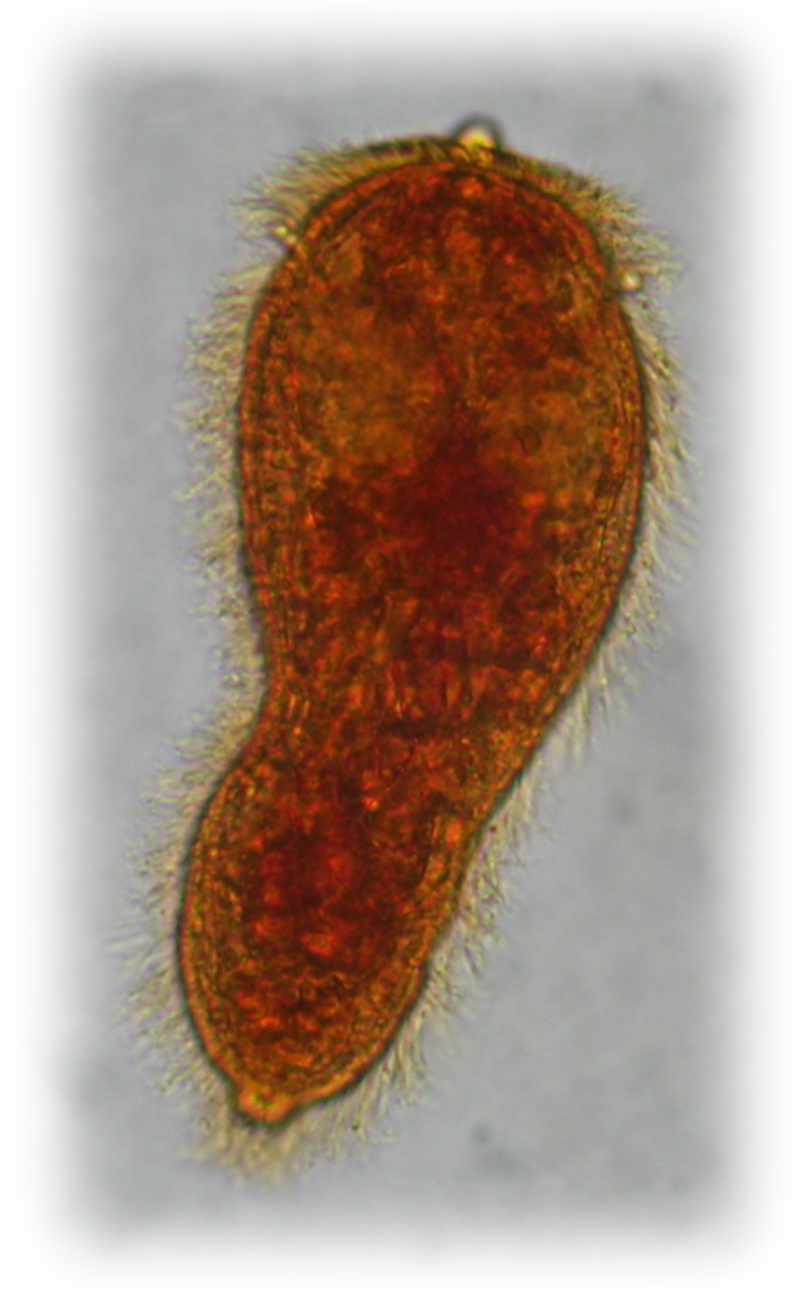
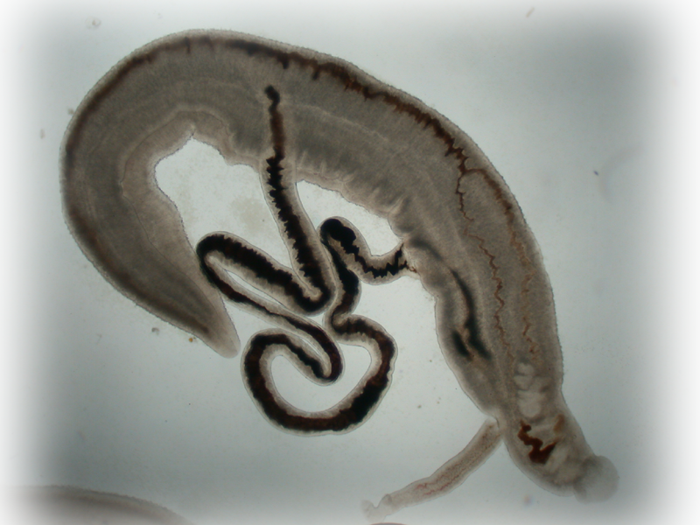
Schistosomiasis (Bilharziasis):

Slide 32
Trematodes can be classified according to site of infection
Lung flukes
Liver flukes
Intestinal flukes
Blood flukes
P.westermani
C.sinensis
F.hepatica
F.gigantica
F.buski
Schistosome spp.

Slide 33
3 Species of Human Schistosomes
Habitat
Distribution
Schistosoma mansoni
Mesenteric veins
Drain from LI
Egypt, Africa
S. America
S. haematobium
Vesical & pelvic plexus
Egypt, Africa
S. japonicum
Mesenteric veins
Drain from SI
South East
Asia

Slide 34
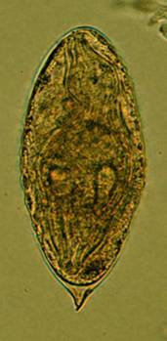
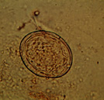
Eggs:
commonest S. mansoni - lateral spine
Eggs with apical spine - S. haematobium
S. japonicum ovoid eggs with knob

Slide 35
Pathology of established S. mansoni and S. japonicum
Chronic lesions found
in intestines (scattered granuloma)
liver
Focal granulomas most frequently found in rectosigmoid colon in S. mansoni
Small intestine is lightly affected

Slide 36
Clinical Manifestations Intestinal schistosomiasis
Majority symptom free or have minimal or non-specific symptoms
If present
Chronic or intermittent diarrhoea
Blood in stools
Abdominal discomfort or pain
Colicky cramps
Secondary symptoms
Fever
Anorexia
Weakness
weight loss

Slide 37
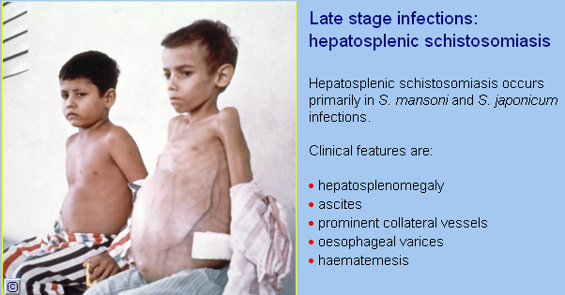

Slide 38
Thank you

